Slide 1
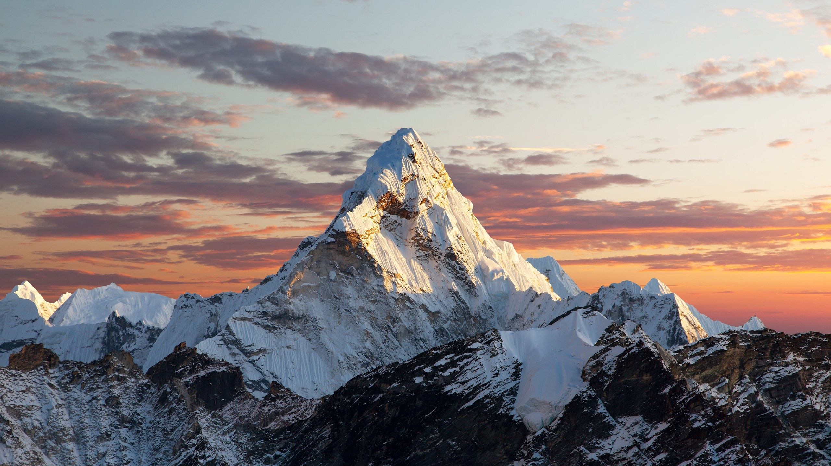
Mount Everest
top Sight food hotel contact
TEL
080-9860-5613
世界の一部高い山です。皆さんぜひ遊びに来てください。

Slide 2
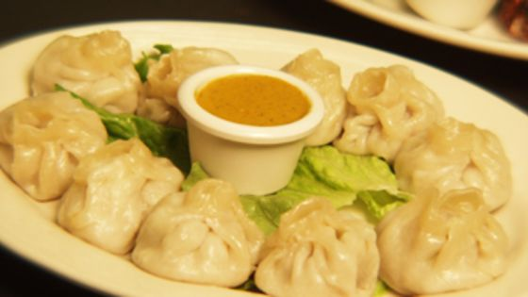
Mount Everest
Manakamana Resturent hakata
Addrss fukuokashi fukuokaken 3cheume hakata
New momo VEJI momoRS:500
TELー080-9860-5613

Slide 3
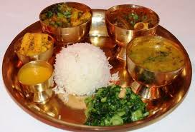
Mount Everest
Choosing a healthy breakfast RS:600
TL.9845663310

Slide 4
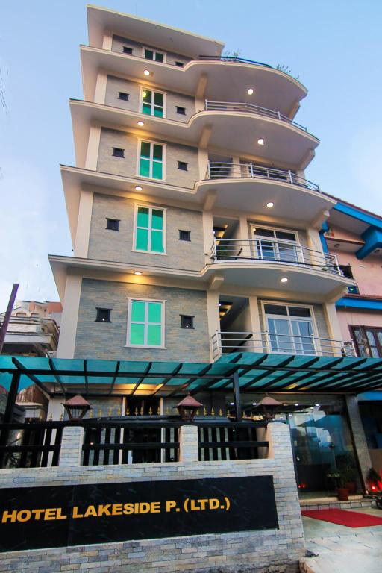
Mount Everest
HOTEL LAKESADE
Addrss fukuokashi fukuokaken hakata 3cheume
Room price only RS.5000
TEL.080-9860-5613

Slide 5
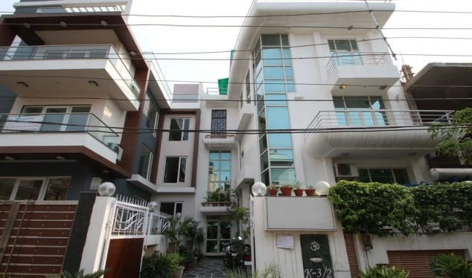
Mount Everest
MOUNT EVEREST HOTEL MUSTANG NEPAL.
ROOM PRICE ONLY RS:6000

